Slide 1
LEAD POISONING
Dr. Reshma Reghu
Lecturer,
Dept of Community Medicine

Slide 2
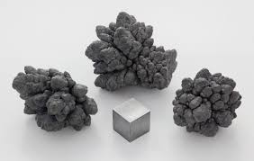
Properties
Low boiling point
Form alloy
Easily oxidised
Anticorrosive

Slide 3
Lead Compounds- Toxic
Lead arsenate
Lead oxide
Lead carbonate
Lead sulphide- least toxic

Slide 4
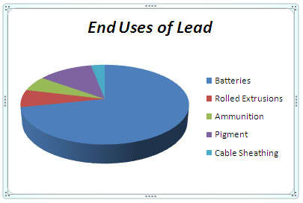
Industrial Uses
200 industries
Storage batteries
Glass Manufacture
Ship building
Printing &Potteries
Rubber industry etc…

Slide 5
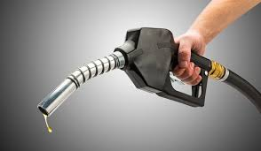
Non- Occupational Sources
Gasoline
Automobiles
Lead pipes
Toys
Lead paints

Slide 6
Mode of Absorption
Inhalation
Ingestion
Skin

Slide 7
Body Storage
Average adult- 150 to 400 mg
Average Blood level- 25 μg/100ml
>70 μg/100ml shows clinical symptoms
Normal adult ingest about 0.2 to 0.3 mg of lead per day

Slide 8
DISTRIBUTION IN THE BODY
95% enters the Erythrocytes
Liver & Kidney
Bones
Soft tissues

Slide 9
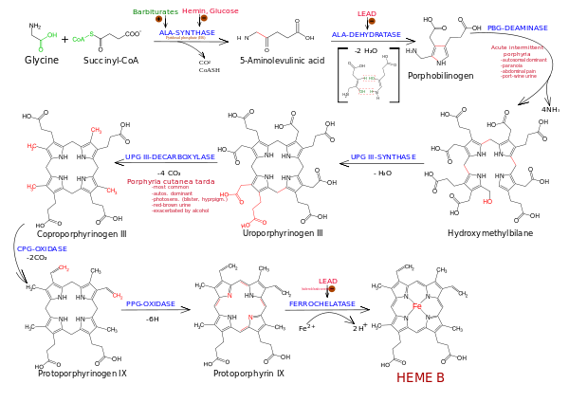
PORPHYRIN SYNTHESIS

Slide 10
Combines with essential SH- groups
Affects the porphyrin synthesis
Carbohydrate metabolism
Membrane permeability
Potassium leakage

Slide 11
CLINICAL PICTURE
Toxic effects of Inorganic lead exposure
Abdominal colic
Obstinate constipation
Loss of appetite
Blue lines on gums
Stippling in red cells
Anemia
Wrist drop
Foot drop

Slide 12
Effects of Organic lead compounds
Affects the CNS
Insomnia
Headache
Mental Confusion
Delirium

Slide 13
DIAGNOSIS
History
Clinical Features
Laboratory test
-Coproporphyrin in urine >150 μg/litre
- Aminolevulinic acid in urine > 5mg/litre
-Lead in blood and urine (0.2 to 0.8 mg )
- Basophilic stipling of RBC

Slide 14
PREVENTIVE MEASURES
Substitution
Isolation
Local exhaust ventilation
Personal protection
Good house keeping
Working atmosphere
Periodic examination of workers
Personal hygiene
Health Education

Slide 15
MANAGEMENT
Prevention of further exposure
Removal of lead from soft tissues
Prevention of recurrence
Early recognition of cases
Saline purge
d-penicillamine
Lead poisoning is a notifiable and compensatable disease in India since 1924.

Slide 16
OCCUPATIONAL CANCER
Skin Cancer
Lung Cancer
Cancer Bladder
Leukemia

Slide 17
SKIN CANCER
Percival Pott- CA Scrotum – Chimney sweeps- 1775.
Coal –tar, X-rays, Certain oils, Dyes
75%- Skin Cancer
Gas workers, Coke Oven workers, Tar Distillers, Oil Refiners, Dye- Stuff Makers, Road makers etc..

Slide 18
LUNG CANCER
Gas industry, Asbestos Industry, Nickel & Chromium work, Arsenic roasting plants, Mining in radioactive substance, Cigarette smoking etc..
Arsenic, Beryllium, Isopropyl oil- Carcinogens
>9/10- Tobacco smoking, Air pollution, Occupational hazard

Slide 19
CA BLADDER
First noted in aniline industry- 1895
Caused by aromatic amine metabolised in the body and excreted in urine
Industries- Dye stuffs, dyeing industry, Rubber, gas and electric cable industry
Carcinogens- Beta-naphthylamines, Benzidine, para-amino-diphenyl, auramine, magenta

Slide 20
LEUKAEMIA
Exposure to benzol, X-ray, radio-active substance
Benzol is a dangerous chemical which is used as a solvent in many industries
Appear long after exposure has ceased

Slide 21
Characteristics of Occupational Cancer
After prolonged exposure
The period between the exposure and development of disease may be as long as10 to 25 years
Disease may develop even after cessation of exposure
Average age incidence is earlier in that for cancer in general
Localization of the tumor is constant in any one occupation

Slide 22
CONTROL
Elimination or control of industrial carcinogens
Medical examination
Inspection of factories
Notification
Licensing of establishments
Personal hygiene measures
Education of workers and management
Research

